Slide 1
Graph
Il-Chul Moon Dept. of Industrial and Systems Engineering KAIST
icmoon@kaist.ac.kr
Notes:
Today, we'll start learning about graph structure.

Slide 2
Weekly Objectives
This week, we study graphs.
Objectives are
Understanding the data structure of graphs
Able to implement the data structure for dense graphs
Able to implement the data structure for sparse graphs
Understanding the operations of graphs
BFS and DFS traverse
Understanding the algorithms on graphs
Dijkstra’s shortest path algorithm
Minimum Spanning Tree
Notes:
We'll be studying graph structure this week.
First, we need to know about the structure.
In order to do so, we need to understand what kind of data is in the graph.
Just like when you learned about trees for the first time, we have to learn new terminology and understand the characteristics of different data.
Then, we'll take a look at the way graphs work.
In addition to insert and delete, there's also BFS and DFS.
These work not only with trees, but also with graphs. We'll take a look at what these are.
Graphs can run a variety of algorithms.
We need to understand and apply these algorithms.
We'll learn about algorithms that can solve various tasks, such as how to find the quickest route on GPS through a minimum spanning tree.

Slide 3
Graphs
Examples of ordered collections, where each item may have successors and predecessors :
List : one predecessor, one successor at most
Tree : one predecessor (parent), several successors (children)
Graph : several predecessors and successors
Graph G = (V, E)
V = { v_{i} } : a finite non-empty set of vertices (or nodes)
E = { e_{i} } : a finite (possibly empty) set of edges (or arcs)
e_{i} connects two vertices in V
4
4
2
9
3
9
7
7
3
3
1
1
2
Unlabeld vertices
5
Labeled vertices
5
Labeled vertices
And Weighted edges
Notes:
Let's take a look at the different types of graph structures there are.
Here's a well-organized data collection.
To start off, the list is ordered.
Although it wasn't easy to decide the order in trees, they were still a collection with an order called parent and child.
Graphs are also a type of ordered collection, but they're different from trees.
Let's take a look at a picture that explains this.
When we think of lists, we think of this kind of structure.
A tree can be seen as an expansion of lists.
In case of a binary search tree, it could stretch out sideways on both the left and righthand sides.
Here, we also have the prev node, which is a list that can go to its "previous" place.
Now, a bunch of these can connect without limit.
This freely connected state is what we can call the graph structure.
We can use reference structure to figure out how we can traverse across all this data or find the shortest path. We'll learn how to do all this.
From another perspective, a list has a "prev" and a "next."
Remember, a tree has one parent and multiple children.
Graphs, on the other hand, can have multiple prev and next.
The formula for a graph can be written as follows.
G is the combination of V and E.
V is a set of vertices or nodes.
E is the set of edges.
An edge is also called an arc or a link.
This is what we call a vertex or a node.
The circle is becoming a node.
This line here is what we call an edge, link, or an arc.
Next, we have what are called unlabeled vertices.
That’s because there are no labels.
These have all the labels. So, they're labeled vertices.
They're labeled very well, and each edge has weight.
Now, we've learned about vertices and edges. Graphs are a combination of sets of vertices and sets of edges.

Slide 4
Graph terminology
adjacent, neighbor, incident
path between A and B : a sequence of edges connecting A and B
connected graph : path from each to every other vertex
connected component : graph subset containing the set of vertices reachable from a vertex and their edges
complete graph : edge for every pair of vertices
dense graph : close to complete graph |E| = O(|V|²)
sparse graph : far from complete graph |E| = O(|V|)
Adjacent vertex or Neighbor
Adjacent vertex or Neighbor
4
4
4
4
9
9
9
9
7
7
7
7
3
3
3
3
5
Disconnected
Graph
5
Connected
Graph
5
Connected
Component
5
Complete
Graph
Notes:
There are various terms related to graphs.
There's one called "adjacent" or "neighbor."
If they're right next to each other and bound by an edge, they are adjacent vertices. In other words, they’re neighbors.
A "path" is a sequence of edges connecting A and B.
For example, the path between 3 and 7 are edges 1 and 2 that connect vertices 3, 4, and 7.
There are also edge 3 and edge 4 that connect 3, 5, and 7.
A path is a bunch of edges that travel from one node to another.
A connected graph is a graph in which a path to every other vertex exists.
This is not a connected graph.
Since there is no path to vertex 9, this a disconnected graph.
On the other hand, this is a connected graph.
Each graph is made up of components.
This disconnected graph has two components.
We call the connected subgraph a component.
A connected component can be defined as a graph subset containing the set of vertices that can be reached from a vertex and their edges.
This is a subset that has a path you can plan.
This single node is also a component.
So, this graph comprises two components.
A complete graph has edges for all vertices of all pairs.
This graph has five nodes.
When these five nodes have edges that can reach all other nodes, this will be a complete graph.
For example, if there are five nodes, there are a total of four "other nodes" to reach, leaving 20 pairs in the graph.
But for now, we don't have any criteria for the direction of the edges. So, we divide by 2 to find that we need 10 edges.
You can count for yourself to see why we need 10 edges.
We've now defined the complete graph.
In many cases, graphs have far fewer edges compared to complete graphs.
This is because as the number of vertices increase, the number of edges needed increases quadratically.
For example, if the number of edges increases at a similar rate as the number of vertices, you'll end up with a lot of edges.
This is called a dense graph.
If there aren't that many edges, and if each vertex has only one edge, this is called a sparse graph.
Most graphs would be somewhere between sparse and dense graphs.
The number of edges in the graph changes the way these are stored.

Slide 5
Graph terminology
Cycle : a path starting from a node and ending the node itself
Directed edge : an edge with direction (source and destination)
Digraph : Directed graph.
Graph with directed edges
DAG : Directed Acyclic Graph
Directed graph without cycle
Destination
Source
4
4
4
4
9
9
9
9
7
7
7
7
3
3
3
3
5
Cycle
5
Directed Graph
Or Digraph
5
Cyclic
Digraph
5
Directed Acyclic
Graph or (DAG)
Notes:
Let's take a look at some more terminology.
There is something called a "cycle" that can exist in graphs.
A cycle is a path that begins from a certain node and ends at that same node.
A path that starts at 3 and returns to 3 would be a cycle.
Cycles can exist in these types of situations.
If you begin at 3, go to 4, followed by 7, and then back to 3, you end up with a very good cycle.
On the other hand, there are edges that have a direction.
These are called directed edges.
So, there's an order of sequence to these.
Here, we've only marked the connection between 7 and 4. But over here, we see that the edge is going from 7 to 4.
7 becomes the source, and 4 becomes the destination in this directed edge.
Graphs that use directed edges are called digraphs or directed graphs.
You can also have a directed graph with cycles.
Here we don't have a cycle.
For example, if we go from 5 to 7, go to 4, go to 3, and then to 5 again, we complete the cycle.
But since there's no edge from 3 to 5 here, the cycle doesn't exist.
But when we change the direction of the edge, we have a cycle.
Such graphs are called cyclic directed graphs.
Cyclic directed graphs, however, aren't critically important.
Later, you'll see a lot of directed acyclic graphs in fields like machine learning.
Although this is a directed graph, it is not cyclic.
So, we call directed graphs without cycles as DAG.
There are the following types of graphs that fall under DAG.
DAG has a tree structure, and can be easily converted. It therefore attracts many users. It can also be used for probability modeling.

Slide 6
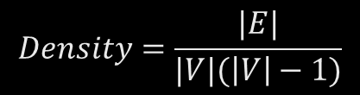
Data structure for graphs
To store a graph
Store a set of vertexes
0,1,2,3,4,5,6,7,8,9
Store a set of edges
(0,1), (1,3), (2,0), (5,3)…
How to store?
Storing vertexes
Simple.
Linked list, BST, Hash….
Store edges
Fundamentally, a pair of values
Initially, a two-dimensional matrix
Space: O(V²)
Time: O(1)
However….
Graph density becomes problem
So, adjacency list
Space: O(E)
Time: O(E)
$$Density=\frac{|E|}{|V|(\left|V\right|−1)}$$
0
2
1
Sparse graph
= Density→0
3
Dense graph
= Density→1
5
7
4
9
6
8
Notes:
So, we've created a directed graph that we talked about earlier.
Let’s say we have a total of 10 vertices, from 0 to 9.
Grouping the edges by source and destination into tuples like (0, 1), (1, 3), (2, 0), we end up with 13 edges.
How could we store this information?
If we save this information well, then we could say that the graph has been saved well.
Saving a vertex is simple.
We use data structures like linked list, BST, and Hash to save the list.
Saving edges, however, is more problematic.
Edges are basically pairs of values.
Since it's a pair, we can say there's a value on one side, and another value on the other side.
If this value exists, we can return 1. If it doesn't exist, return 0. Like so, we can use two-dimensional matrices.
In this case, O(V^2) space is created, or the squared number of vertices.
We can consider time to be a constant since we can just find the value for source and destination in the index and return a value.
However, there may be a problem with this.
The result can vary, depending on the density of the graph.
The denser the graph, the greater variety of save space is required between the vertices.
When the graph is sparse, most space will just become 0.
Meanwhile, the required save space increases by V-squared, making it difficult to handle increasing vertices.
That’s why we need to figure out a different way to save our graphs.
Now, we can save them in the form of an adjacency list.
We need as much space and time as the number of edges.
So, we can use a matrix or an adjacency list, depending on the graph's density.
Graph density can be measured in the following way:
We start by using the number of edges.
|V| is the number of vertices, while |E| means the number of edges.
This can only be used in directed graphs.
In undirected graphs, the denominator would be cut in half if the graph is possible.

Slide 7
Matrix Representation for Dense Graph
Array Representation : Adjacency Matrix
Linked Representation : Adjacency List
Adjacency Matrix
A[i][j] = 1 if (v_{i}, v_{j}) ∈ E
0 otherwise
Adjacency Matrix for weighted graph
edge weight value
instead of 0/1
 |  | 0 | 1 | 2 | 3
 |  | A | B | C | D
0 | A | 0 | 0 | 0 | 0
1 | B | 1 | 0 | 1 | 1
2 | C | 0 | 0 | 0 | 0
3 | D | 0 | 0 | 1 | 0
A
D
B
C
 |  | 0 | 1 | 2 | 3
 |  | A | B | C | D
0 | A | 0 | 0 | 0 | 0
1 | B | 7 | 0 | 11 | 5
2 | C | 0 | 0 | 0 | 0
3 | D | 0 | 0 | 2 | 0
A
7
5
D
B
2
11
C
Notes:
In dense graphs, it is much more beneficial to use a matrix when storing.
This is because there is much to be saved, leaving only a few 0s that need to go in the matrix.
The term adjacency matrix is used in this saving process.
If you use a linked list, it's called an adjacency list.
The adjacency matrix can be defined as follows.
A[i][j] = 1 means that there is an edge that goes from vertex i to j.
If the value is 0, then that means the edge doesn't exist.
In this case, the adjacency matrix becomes 1 if it exists, and 0 if it doesn't.
If the adjacency matrix is being created for a weighted graph, you would save the edge weight instead of 0 or 1.
Take a look at the example on the right.
Here is a graph called A B C D.
Let's write the vertex on the row and column.
This vertex can be saved into a variety of data structures.
We'll set the id for A to 0, B to 1, C to 2, and D to 3.
Now here, we have an edge that goes from B to A.
B's index is 1, and A's index is 0.
The value of the adjacency matrix [0,1] has to become 1.
That value is expressed like this.
In this case, the [1,2] of the adjacency matrix becomes 1, expressing the edge from B to C.
The edges expressed as 1 like this form the adjacency matrix.
The same goes for the weighted situation.
While it was expressed as 0 and 1 before, since it is weighted, the weight values of the edges are expressed on the matrix.
Even here, there is no index for the source and destination.
So, we looked at how to save dense graphs using matrix representation.
The important thing is that there are only four slots here that aren't 0s out of the 16.
Many spaces are filled with 0s, making it what we call a sparse form of saving values.
We’ve got plenty of space to work with. But since we might have to handle a very large network, we might not have enough memory to be this inefficient with storage.

Slide 8
Adjacency List Representation for Sparse Graph
Adjacency matrix : storage waste for sparse graph
Adjacency list
For each vertex, make a linked list of edges starting from the vertex
Edge weight can be stored in ‘Edge’
Storage efficient
Vertex (name, list of edges)
A
Edge (end vertex, cost, next edge)
A
7
5
D
B
B
A
7
C
11
D
5
2
Graph
11
C
C
D
C
2
Notes:
When saving sparse graphs through matrix representation, we use the list format to prevent inefficiencies.
The adjacency matrix method incurs storage waste when we save sparse graphs.
With an adjacency list, we use lists to save the graph.
Now, we have to save the vertex, one way or the other.
It doesn't matter what data structure we use. We have to save the vertices.
So, we build an extra linked list for each saved vertex.
This linked list would then manage the edges.
It manages the list starting from that vertex.
So, we connect the linked list to the vertices and save all the vertices. This becomes the graph.
We can also save the weights of the edges as separate values in the linked list.
This is efficient because it doesn't take up as much storage space as the matrix method.
We can save A, B, C, and D as BST, Hash, or linked lists.
We make a reference inside each vertex called A, B, C, and D.
In that reference, we save an edge that starts from that node.
For example, we can save them as the edge going from B to A, from B to C, or B to D.
If we have a weighted graph, we can create nodes to save weight.
If we manage vertices efficiently like this, we can find the starting vertex and look up its linked list to see if it has an edge.
So far, we've said that we use adjacency lists to improve storage efficiency.
However, there are some cases where using the adjacency list is disadvantageous.
When we use the matrix to check for edges, we get O(1). With lists, we get O(E) in the worst-case scenario.
So, we can distinguish the list linked to the vertex as a BST, Hash, or linked list when we save.
But for now, we can just save the vertices and the edges as linked lists, which is the easiest way to do it.

Slide 9
Operations of graph data structure
Operations on graphs
Operation of retrieving vertexes
BFS traverse
DFS traverse
Operation of finding shortest paths
The shortest path
From vertex 1
To vertex 9
Operation of finding a set of path to control whole vertexes
The minimum spanning tree
0
2
1
3
5
7
4
9
6
8
Notes:
We’ve just learned how to save this information called graphs.
Now let's take a look at what kind of operations are possible with graphs.
One thing we have to cover when we discuss graphs is traversing.
We'll skip over operations like add or remove, since they're easy to implement once you get used to the reference structure.
If you study the detailed data structure, you can easily add or remove.
Traversing, however, has its own unique traits when it comes to graphs. That is why we should cover it now.
Traversing is a task to pull out all vertices.
Using linked lists was very easy.
We didn't even need to traverse.
We started getting into traversing issues with trees.
Since trees didn't have an ordered sequence, we used BFS and DFS.
The same goes for graphs.
So, we can look at both BFS and DFS in this case.
After that, we can try to find the shortest path.
For example, we would find the shortest path between 1 and 9.
If we have 1, 0, 2, 9, we could go through three paths from 1 to 9.
Alternatively, we could go to four vertices.
So, it's important to find the shortest path like this.
Then, we find the set of edges that can control the entire vertices.
We find this issue of finding the base camp for vertex in telecommunications and logistics.
So, with these issues, we use the minimum spanning tree.
Let's say we have to reach a point called 5. We then have to find out how to control which vertex through which edge.
Before, we would spend time covering add or remove. This time, we'll take a look at a problem unique to graphs.

Slide 10
Detour: Tree traversing
Tree
Complicated than a list
Multiple ways to show the entire dataset
If it were a list
Just show the values from the beginning to the end
Since this is a BST
You have to choose what to show at a time
The value in LHS
The value in RHS
The value that you have
Hence there are multiple traversing approaches
Inserting 3, 2, 0, 5, 7, 4, 6, 1, 9, 8
LHS
RHS
Level 1
3
Level 2
2
5
Level 3
0
4
7
Level 4
1
6
9
Level 5
8
Notes:
This is what we've been discussing.
With a binary search tree like the following, we need to figure out how to extract all information from here.
We'll tackle this through a "level-wise" or "breadth" approach.
Then, we can take them out in order: 3, 2, 5, 0, 4, 7, 1, 6, 9, 8.
We used something called a "queue" to do this.
We were then able to follow with a “depth first search.”
This method goes all the way down and takes out the data through recursion using the pre, post, and in methods.
Here, we used stack to conduct traversing.

Slide 11
DFS vs. BFS traverse on graphs
DFS utilizes
Stacks, or recursions that imitates the stack operations
Pre-order traverse
In-order traverse
Post-order traverse
In graphs, often only pre-order traverse is used
BFS utilizes
Queues
Lever-order traverse
Having said this,
Tree is a directed acyclic graph.
Graph may not be a DAG
Then….
You have to check the repeated visits to avoid falling into a cycle
0
2
1
3
5
7
4
9
6
8
Notes:
We can apply the same traversing, BFS, and DFS approaches to graphs.
Let's start with a depth first search.
Depth first search uses stack and recursion structures.
Within that, there are Pre-order, In-order, and Post-order.
Pre-order is when we print the current node first and then print the child.
In-order traverses to the left-hand side, current, then right-hand side.
Graphs, however, don't distinguish between left and right-hand sides.
So, in this case, in-order traversing doesn't exist.
Post-order traversing prints all the way down and then prints the current node.
However, pre-order traversing is also used from time to time with graphs.
It's simply too complicated to go with post-order.
At least with trees, it was clear where we can start because we had roots.
With graphs, we don't have any roots. We need to designate a starting point.
So, let's say we designated 5.
Nodes 3, 4, and 7 are connected to 5.
So, if we picked 3, we print 5 first, then move to 3 to print 3. If we go to 4 from here, we have a breadth first search. If we go to the neighbor of 3, we have a depth first search.
3 can only go to 2. There's nowhere left to go after you go from 2 to 0 to 1.
In trees, we can't go from the child to root, which would create a cycle.
But cycles can occur in graphs.
So, we need to save all the nodes we traversed before.
When recursion occurs, we need to turn over all the nodes we've traversed thus far.
When everything is returned, we come back to 5. We can then go somewhere else again.
Now, let's go to 4.
We go from 4 to 6 to return.
Taking out the information from all the vertices is what DFS does.
So, we looked at how DFS works.
Now let's look at BFS.
BFS still needs to use queues with graphs.
They follow level-order traversing.
Let's take a closer look as we examine how it moves.
So, when we have 5, we put 5 in the queue and take it back out again.
It's just like how BFS works with trees.
Then, we enqueue 3, 4, 7, which are 5's children.
We print 5, then move on.
With 3, 4, and 7 enqueued, we then enqueue 2, which is 3's child.
Then, 4 comes out, so we enqueue 6, which is 4's child.
Let's write this all out.
As 5 gets dequeued, its children 3, 4, 7 are enqueued.
As 3 gets dequeued and printed, its child 2 is enqueued.
Also, as 4 is dequeued and printed, 2 is enqueued.
As 7 is dequeued and printed, 9 is enqueued.
As 2 is dequeued and printed, 0 is enqueued.
6 is dequeued and printed, but nothing is enqueued because 6 has no children.
As 9 is dequeued and printed, its child 8 is enqueued.
As 0 is dequeued and printed, 1 is enqueued.
As 1 is dequeued and printed, its child 3 should be enqueued. However, since we've already traversed there, we end without enqueuing.
Since not all graphs are acyclic, we have to always check for cycles to see if we aren't going back to where we've already traversed when we run DFS or BFS.

Slide 12
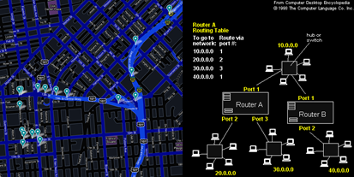
Single-Source Shortest Path Problem
One recurring problem in graph
Happens in
Path finding
Routing on comm. networks
Social networks
We know where we are
We want to know how long to travel to our destination
Terminology
Source = where we start
Destination = where we arrive
S
(0)
20
2
(8)
3
5
1
(3)
7
6
15
D (13)
3
(9)
4
Notes:
Now, we’ve covered the definition of the operation called traversing.
Next, we'll learn about the single-source shortest path problem.
This is dealt with often in graphs.
This problem is used for path finding in GPS receivers, routing on comm.networks, and social network services.
The prerequisite for this is that we need to know which source we'll start from.
Then, we want to know how long it will take to reach our destination.
We can see that it takes 3 units of time to go from this source to 1.
But we don't know which path presents the best case to reach the destination from our source.
So, this algorithm helps us find the shortest path.
In terms of terminology, "source" is where we begin and "destination" is where we're going.
When we talked about directed edge, there was also a source and destination, or the starting and ending points for the edge.
In this case, the source and destination are for the path.
So, we'll take a look at the most frequently used algorithm to find the shortest path.

Slide 13
Detour: Dynamic Programming
F(4)
Dynamic programming:
A general algorithm design technique for solving problems defined by or formulated as recurrences with overlapping sub-instances
In this context, Programming == Planning
Main storyline
Setting up a recurrence
Relating a solution of a larger instance to solutions of some smaller instances
Solve small instances once
Record solutions in a table
Extract a solution of a larger instance from the table
F(3)
F(2)
F(2)
F(1)
F(1)
F(1)
F(0)
F(0)
Memoization Table
Instance | Solution
F(0) | 0
F(1) | 1
F(2) | 1
F(3) | 2
F(4) | ?
Notes:
I’m planning to reuse dynamic programming to carry out the shortest path planning that I’ve mentioned before.
Before proceeding any further, let’s just briefly recap dynamic programming and what it is.
It is the structure of a recursion that calculates the Fibonacci sequence.
To get the first 4th Fibonacci sequence, we should get the 3rd and 2nd numbers.
However, there were some iterated parts.
It calculated the 2nd Fibonacci sequence twice and the 1st Fibonacci sequence three times.
So, we’ve learned about dynamic programming that does not start from the 4th number but from the 0th number to incrementally compute larger numbers.
Using this dynamic programming, we would get the shortest path available.

Slide 14
Detour: Tracing Assembly Line Scheduling in DP
Assembly Line 1
station S_{1,1}
station S_{1,2}
station S_{1,3}
station S_{1,4}
station S_{1,5}
station S_{1,6}
7
9
3
4
8
4
2
1
3
4
3
2
3
Production Start
Production End
2
1
2
2
1
4
2
8
5
6
4
5
7
station S_{2,1}
station S_{2,2}
station S_{2,3}
station S_{2,4}
station S_{2,5}
station S_{2,6}
Assembly Line 2
Time | 1 | 2 | 3 | 4 | 5 | 6
L1 | 9 | 18 | 20 | 24 | 32 | 35
L2 | 12 | 16 | 22 | 25 | 30 | 37
Trace | 1 | 2 | 3 | 4 | 5 | 6
L1 |  | 1 | 2 | 1 | 1 | 2
L2 |  | 1 | 2 | 1 | 2 | 2
Notes:
We’ve already practiced this method before.
As handled in the assembly line scheduling, we used a memoization table and retrace table to find the shortest path.
We were able to learn how to achieve the shortest time by taking different lines at different times.
If you don’t remember how to do it, you can just revisit the lesson from the week we covered dynamic programming.
It does not differ from path planning.
It’s basically the problem of finding which route is the best from the start point to the end point.
The numbers such as 2 and 2 here could be viewed as the weight on the path.
In this way, there is an edge weight and this is a graph structure.
So, we’ve actually dealt with shortest path planning while we learned about dynamic programming.
If we define it in terms of a general structure, it’s Dijkstra’s algorithm.

Slide 15
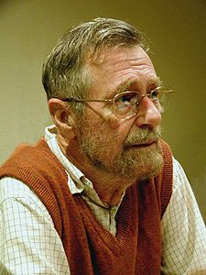
Dijkstra’s algorithm
Computer science is no more about computers than astronomy is about telescopes.
Memoization Table
V = the set of vertexes
W = the set of weights on edges
s = the source vertex
Dijkstra’s algorithm(V, W,s)
dist = {}
For itr in V
dist[v] = 99999
dist[s] = 0
While size(V) != 0
u = getVertexWithMinDistance(V, dist)
V.remove(u)
For neighbor in getNeighbors(u)
If dist[neighbor] > dist[u]+w(u,neighbor)
dist[neighbor] = dist[u]+w(u,neighbor)
Return dist
Retrieving minimum distance from a list. Does that ring a bell?
S
(0)
20
9
D (20)
3
(9)
4
Will I update the time 20 with time 9+4?
Somehow, I know it takes 9 to reach 3
Notes:
Let’s find out about Dijkstra’s algorithm.
This is Dijkstra, who made a great achievement in the field of computer science.
First, let’s define the graph structure in the following manner.
V is defined as a set of vertices, and W is a set of weights on ab edge.
These details of a graph data structure are inevitable in every graph.
Then, we need an input by an algorithm.
Now we’re doing the single source shortest path.
So, I would write the source vertex as an input of the algorithm.
s represents a single source parameter.
Now let’s run the Dijkstra algorithm.
At first, we would determine a distance and leave it as an empty table.
Any sort of dynamic programming requires a specific table that stores the past calculation data. This is called a memoization table.
The Dijkstra algorithm is the process of storing and growing the data on distances that we have so far by the current point of time.
At first, the distance has a value of 99999, meaning infinity.
As the distance of the starting point is itself, it is 0.
Consequently, the current source starts from 0.
Then, there is a set of vertices called V. When the size of the set is not 0, it will run a while loop.
The loop keeps on going until the vertices are completely consumed.
This process builds up the size of a problem by adding vertices one by one.
Then it fetches one of the remaining Vs with the smallest distance.
At first, the distance on the source is the smallest, as it is 0.
Let’s make the starting source vertex u.
When the source vertex is visited, it is omitted from V.
Now it will fetch the neighbor vertex of the source vertex.
Let’s suppose that D could be converted into 20 in s.
The distance leading to the neighbor is set to infinity.
However, the distance at the current source is 0.
Therefore, 0 plus 20, the actual weight, is smaller than infinity.
So, the value of infinity turns into 20.
As a result, the distance in the memoization is updated from infinity to 20.
After all these tasks are conducted for all the neighbors, it moves up again to search for vertices with the minimum distances. It then carries out the process of expanding neighbors.
One thing that should be noted is that regardless of whether an actual visit is made, “get neighbor” should fetch all neighbors.
To see why this algorithm works, let’s consider a situation like this.
Here, 0 refers to the values in the memoization table that we’d call distance.
20 is a weight value from the edge.
Thus, the update takes place in expanding the covered vertices using the value.
Let’s say that it happens to store a value of 0 in the distance. 3 is newly added to be covered by u.
Then, there is a distance called 9 with the neighbor D.
In the past, we could go a distance of 20 with D.
We currently don’t know which path has passed through with 3, but there is a path that reaches it with a distance of 9.
Let’s assume that we are able to go to D with a distance of 4.
Thus, if we take a route that passes through 3 to arrive at D, it only takes a time of 13.
The previous method took 20.
Then, 20 no longer satisfies the shortest presumption. It is thus updated to the value 13.
The more the vertices that need to be covered, the smaller this value.
The reason for these diminishing values is due to the updates that gradually reduce the value by an inequality sign in this if statement.
Therefore, the principle of Dijkstra’s algorithm is that if we cover all the nodes, we can get the shortest value.

Slide 16
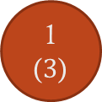
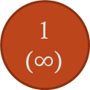
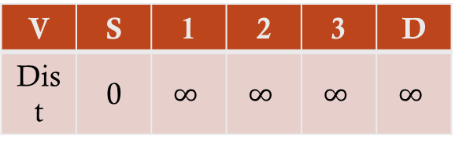
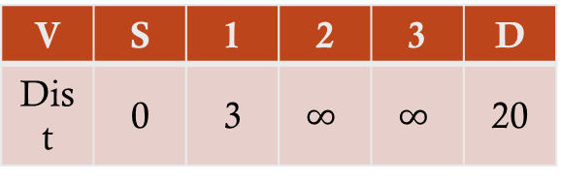
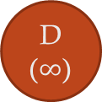
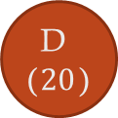
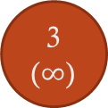
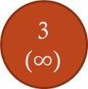
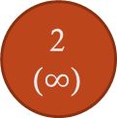
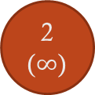
Progress of Dijkstra’s algorithm (1)
S
(0)
20
S
(0)
20
2
($∞$)
2
($∞$)
3
5
3
5
1
($∞$)
1
($3$)
7
7
6
15
15
6
D ($∞$)
D ($20$)
3
($∞$)
3
($∞$)
4
4
V | S | 1 | 2 | 3 | D
Dist | 0 | $$∞$$ | $$∞$$ | $$∞$$ | $$∞$$
V | S | 1 | 2 | 3 | D
Dist | 0 | 3 | $$∞$$ | $$∞$$ | 20
Notes:
We will observe how this operates with an example.
Let’s say there is a graph like this.
The source is here, which becomes the starting point.
Let’s say that we are looking for the shortest distance from the source to D.
This is a memoization table.
To work out the path, we need a retrace table.
Although it isn’t specified yet, we will find it during our exercise.
To travel from the source to the destination, our default setup is that all the vertices are infinity with the source at 0.
Then, we locate the vertex with the smallest value that we have not yet visited in the distance table.
At present, S is the vertex that has the smallest value.
So, S has been selected.
After that, we will find out 1 and D, the neighbor of S.
Although there is a route directly leading to D, it costs 20.
As we add 3 to 0, we could go to 1 with a distance of 3
Consequently, we should update the path to 1 as 3.
D could be reached with 0 plus 20.
D is now updated to 20.

Slide 17
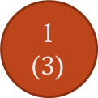
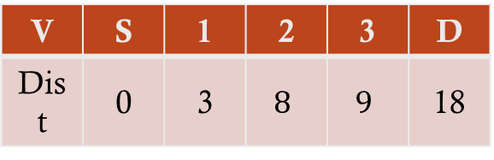


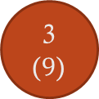
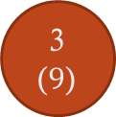
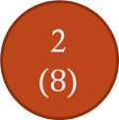
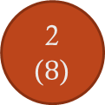
Progress of Dijkstra’s algorithm (2)
S
(0)
20
S
(0)
20
2
($8$)
2
($8$)
3
5
3
5
1
($3$)
1
($3$)
7
7
6
15
15
6
D ($18$)
D ($15$)
3
($9$)
3
($9$)
4
4
V | S | 1 | 2 | 3 | D
Dist | 0 | 3 | $$8$$ | $$9$$ | 18
V | S | 1 | 2 | 3 | D
Dist | 0 | 3 | 8 | 9 | 15
Notes:
As we have visited the source once, it will be omitted from V,
So, the next smallest value vertex, 1, is selected. This is followed by its neighbors, 2, 3, and D.
However, no matter which method is selected, it is possible to reach 1 with a distance of 3.
Therefore, there is no need for us to figure out what are the previous moves.
As we could reach 2 by using 5 more from 1, we will update the infinity value to 8.
Similarly, if we add 6 to 1, we could reach 3 with a distance of 9, again updating the infinity to 9.
While we could reach D by taking a distance of 20 before, now we are able to visit D if we add 15 to 1. Thus, we update 20 to 18.
As a result, the update has been completed for the memoization table with the values of 0, 3, 8, 9, and 18.
In this situation, we would exclude 1 from the V because it went through a vertex. We can then select the smallest value in the memoization, 2.
As we’ve selected 2, its neighbor is only one – D.
While it took a distance of 15 with a distance of 7 from 2 to D, the minimum distance we’ve detected so far was 18.
So, we update the distance 18 to 15.
As we covered up to 2, we’ve found out that it takes a distance of 15 to arrive at D.

Slide 18

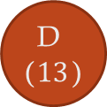
Progress of Dijkstra’s algorithm (3)
Time complexity
O( (|E|+|V|)log|V| )
We will not prove this
|E|
The number can vary
It can be close to
1 = dense graph
0 = sparse graph
If it is a dense graph,
|E| is almost equal to |V| X |V|
Then?
O( |V|²log|V| )
More than a quadratic time complexity
Pretty expensive!
S
(0)
20
2
($8$)
3
5
1
($3$)
7
6
15
D ($13$)
3
($9$)
4
V | S | 1 | 2 | 3 | D
Dist | 0 | 3 | $$8$$ | $$9$$ | 13
Notes:
Lastly, we would select the No. 3 vertex.
As we go through the previous processes, we have the memoization table consisting of 0, 3, 8, 9, and 15.
We’ve visited S, 1, and 2.
The rest includes 3 and D, and we choose the smaller one, 3.
Thus, 3 becomes the u that will be visited next time.
Checking out the neighbors, it produced the value of 15 before. We only need a distance of 13 if we go through 3 to 9 plus 4.
So, the update results in 13.
The remaining one is D, which has no neighbor, so it will end up here.
Thus, we’ve found out that 13 is the shortest distance from S to D.
Through S, 1, 3, D we could go to D with this distance. However, we have not summed up the retrace table that allows us to use this path.
We will deal with that when we do the exercises.
As we’ve learned about this algorithm, let’s simply deal with the time complexity.
This is how we can figure out the time complexity .
We would take the simplest implement method as follows.
As O(E) occurs, it generates O(V^2).
This is because there is a routine to update neighbors and a process of searching for the minimum distance.
As each process deals with every vertex, it takes V^2.
When comparing E and V^2, V^2 is greater.
This is because V^2 is a combination that takes account of every possible edge.
Therefore, it results in O(V^2).
However, this case is a simple implementation.
Now, it can be simplified even further.
If we use a binary heap, it makes it easier.
Using the binary heap, it will make it easier as V transformed into logV during the process of finding the minimum distance.

Slide 19
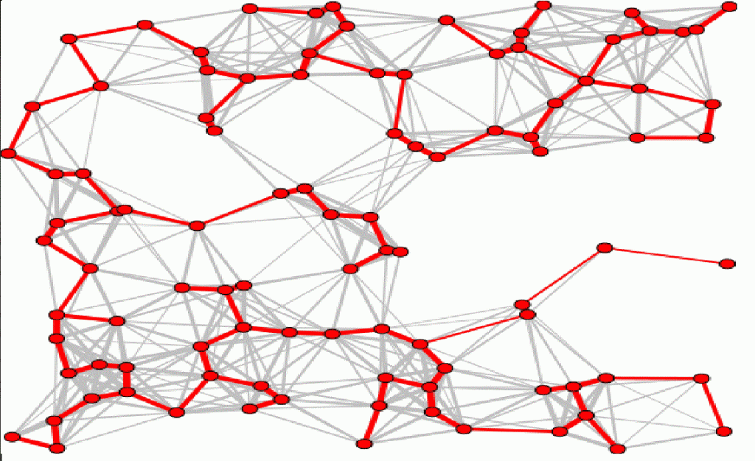
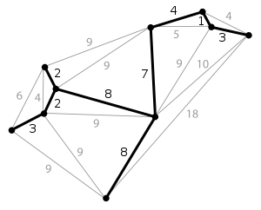
Minimum Spanning Tree Problem
Shortest-path problem
Path planning from a selected source
Many times, algorithm for planning
Minimum spanning tree
Network control problem
All vertex coverage with minimum cost
Algorithm from network design
Telephone network
Electricity grid network
TV cable network
Computer network
Road network
Evolving to the influence propagation tree
Social network influence
From one politician to all tweeter accounts
Notes:
We’ve already confirmed that we can use a Dijkstra algorithm to find the shortest path.
Another algorithm here is designed to locate the minimum spanning tree.
The problem of the shortest path was solved with the Dijkstra algorithm. This algorithm plans the path from the selected source.
The minimum spanning tree is a bit different.
It is not about the length of the path, but about the coverage.
When a certain point is given, it minimizes the path that could cover all the other nodes.
This is useful when it comes to network control issues.
Control in a nutshell is a matter of how to dominate all the nodes.
Therefore, our goal is to find out a way to cover all the vertices at the minimum cost.
They methodology is adopted in various network designs.
The purpose of a path planning algorithm is to discover the minimum path from one node to the other.
This problem is how to find the minimum cost to cover all nodes from a specific location at present.
As it resembles the shape of a tree by dragging this point upwards, it is called the minimum spanning tree.
The reason why it takes a tree shape is because of the absence of a cycle.
If we simplify it, it should look like this.
If we designate this point, it will select edges to cover all the nodes. If we lift here, it takes the form of a tree.
The minimum spanning tree generates a minimum tree that goes through the entire section of a graph.

Slide 20
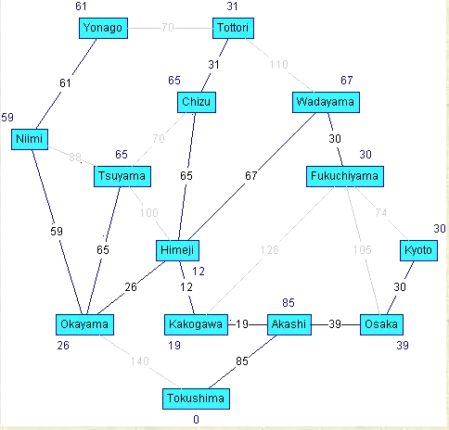
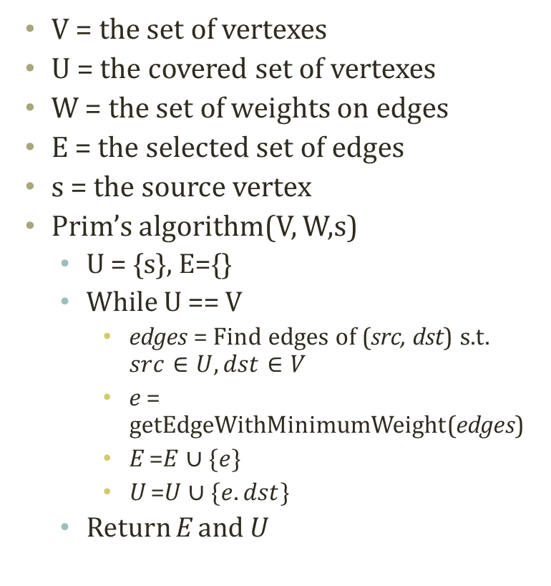
Prim’s algorithm
V = the set of vertexes
U = the covered set of vertexes
W = the set of weights on edges
E = the selected set of edges
s = the source vertex
Prim’s algorithm(V, W,s)
U = {s}, E={}
While U == V
edges = Find edges of (src, dst) s.t. $src∈U, dst∈V$
e = getEdgeWithMinimumWeight(edges)
E =$E∪\{e\}$
U =$U∪\{e.dst\}$
Return E and U
Uncovered Nodes
Covered Nodes
3
1
3
Edges of don’t care
15
9
4
5
Edges of don’t care
13
Edges of don’t care
2
2
20
5
Edges to consider
Notes:
We’ve covered the minimum spanning tree before.
The way to create the minimum spanning tree is to use Prim’s algorithm.
First, V is a set of vertices, and W is a set of weights on an edge. This is essential information found in every graph.
U refers to the covered set of vertices or a collection of data. Remember that we’ve covered this when we studied widening coverage.
Likewise, we can select the edge to be incorporated into the tree. Let’s say the collection of edges is E.
Finally, we also need the source node as a parameter.
Let’s suppose that a given source node was covered with no particular selection for E at the initial stage.
U will be increased with a while loop.
When V-U is not empty, it will keep on going.
V at this point is all the vertices. If we subtract U, it refers to a vertex that is not covered.
Until the non-covered vertex set turns empty, it continues to execute in a loop. Once it becomes empty, it terminates the loop.
“edges” refers to the situation where src is covered . dst means a collection of edges that are not covered by V – U.
Now, we can distinguish between covered vertices and non-covered vertices. Our goal is to find out the edge that bridges the two.
After finding out “edge”, we shall look for the minimum weight edge, or e, and add it to E or the collection of selected edges.
We would also grow U by adding e and dst – that’s Prim’s algorithm.
The edge that we are handling is the edge here.
Looking at this part, we are only interested in edges that bridge covered and non-covered vertices.
The rest of the edges aren’t useful to us in this context.
The edges among the covered node are not necessary, and the edges among the uncovered nodes would not be needed right away.
The edges that concern us now are those that could gradually increase the size of the covered set, while linking the covered and uncovered sets.
Here, it is best to select 3.
If you choose 3, the covered set would rise in this way.
After that, we could consider 15 differently, and 9, 13 and 20 could move on to the bridging node.

Slide 21
Progress of Prim’s Algorithm (1)
1
20
1
20
4
4
3
5
3
5
2
2
7
7
6
15
6
15
5
5
3
3
4
4
V={1,2,3,4,5}
U={1}
E={}
V={1,2,3,4,5}
U={1,2}
E={(1,2)}
Notes:
Just like we did with the Dijkstra algorithm, let’s illustrate this with an example.
At first, we have a graph like this. Let’s say we would devise the minimum spanning tree based on 1.
As U represents a covered set, it only has the source – 1.
In this condition, if we are to augment this set, 3 and 20 are bridged.
These two numbers are the only edge that could start from the covered set and end with a non-covered set.
Among them, we shall select 3, which has the minimum.
Then 2 will be entered into the covered set.
So, 1 and 2 are covered, and the edge called 3 is selected.
After that, we have more bridging edges because we have a greater covered set.
Aside from the existing 20, the vertex of No. 2 joins U so that the edges of 5, 15, and 6 will be bridged.
We shall pick up 5 because it is the smallest.
Then, vertex No. 4 will join the covered set.

Slide 22
Progress of Prim’s Algorithm (2)
1
20
1
20
4
4
3
5
3
5
2
2
7
7
6
15
6
15
5
5
3
3
4
4
V={1,2,3,4,5}
U={1,2,4}
E={(1,2),(2,4)}
V={1,2,3,4,5}
U={1,2,3,4}
E={(1,2),(2,4),(2,3)}
Notes:
After that, 1, 2, and 4 hop to the covered set. 3 and 5 now belong to the non-covered set.
Here, 6, 15, 7, and 20 are bridging edges.
4 is an edge that we will consider later.
As 6 is the smallest in the group, it is selected. Then, 3 will join the covered set.
Now, the bridging edges include 20, 7, 15, and 4. As the smallest one is 4, 4 is selected. 5 then becomes a part of the covered set.
All nodes thus enter the covered set to complete the minimum spanning tree.

Slide 23
Progress of Prim’s Algorithm (3)
Time complexity
O( (|E|+|V|)log|V| )
We will not prove this
Same time complexity to the Dijkstra’s algorithm
1
20
4
3
5
2
7
6
15
5
3
4
V={1,2,3,4,5}
U={1,2,3,4,5}
E={(1,2),(2,4),(2,3),(3,5)}
Notes:
We’ve generated the minimum spanning tree of 1, 2, 3, 4, and 5.
Its time complexity is identical to the Dijsktra algorithm.
I’m not going to explain why this is the case here.
Here we also look for a minimum, which is to be chosen from the bridging edges. It is also possible to choose a heap and others.
In this manner, we can calculate the time complexity in a similar way as the Dijkstra algorithm.

Slide 24
Further Reading
Introductions to Algorithms by Cormen et al.
pp. 527-619

